Slide 1
DHA HOTEL MANAGEMENT SYSTEM
Group Members
Muhammad Anas (cs1810)
Md Usama (cs-1810875)
Haris Meer (cs-181091)

Slide 2
INTRODUCTION
This Project is about Hotel Management. It will deal with multiple modules. For Example:
Room Availability.
Registration Of Guests.
Bill of the Guest.
Restaurant and Bill.
Staff Details.
Delete, Update & Show Records.
Deals with text files to store data.

Slide 3
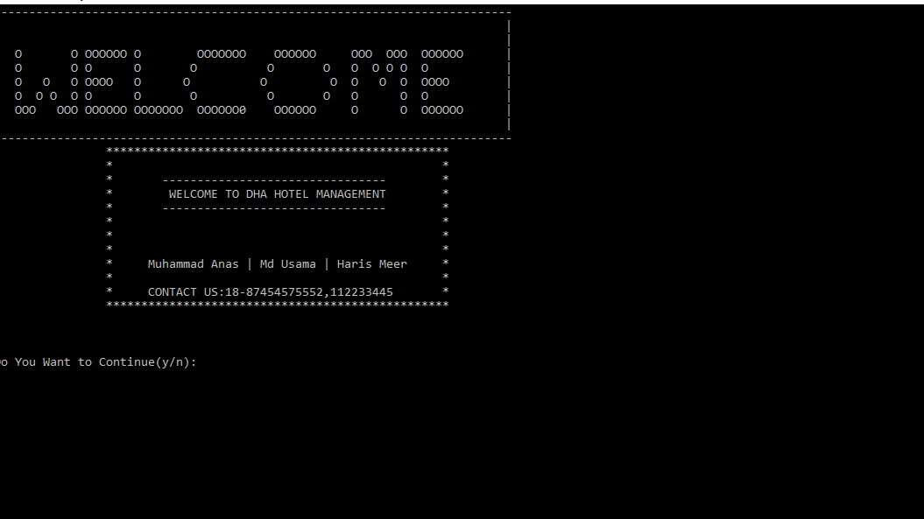
Home Page with Welcome Note

Slide 4
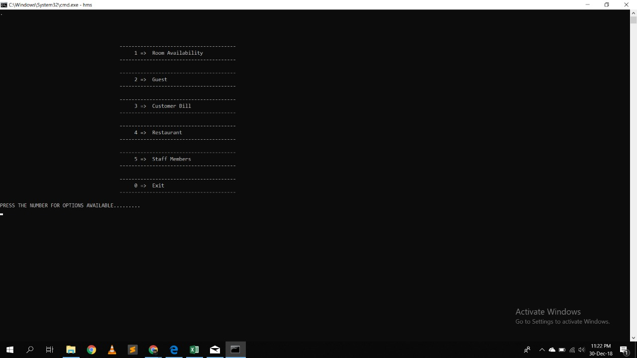
Menu (Enter number for Access to any Module)

Slide 5
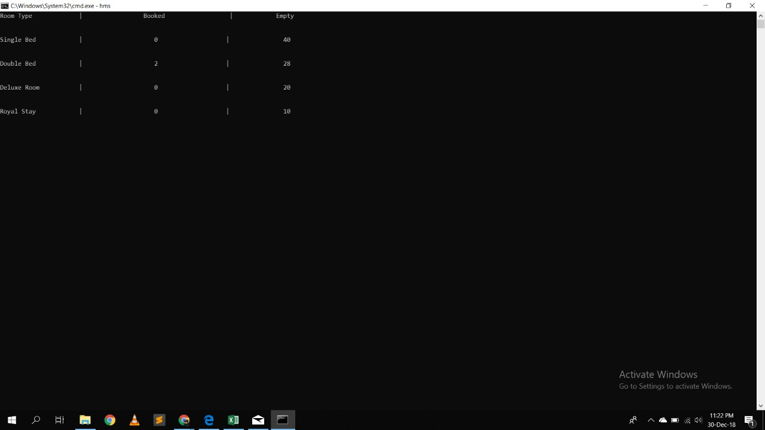
Module 1: Room Availabilty

Slide 6
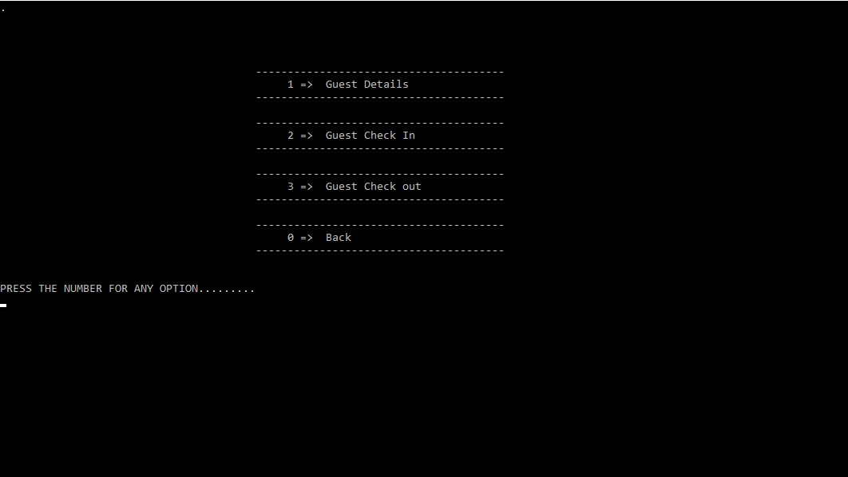
Module 2: Guest

Slide 7
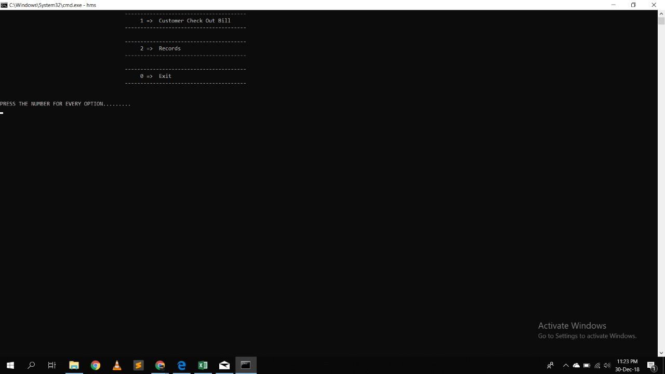
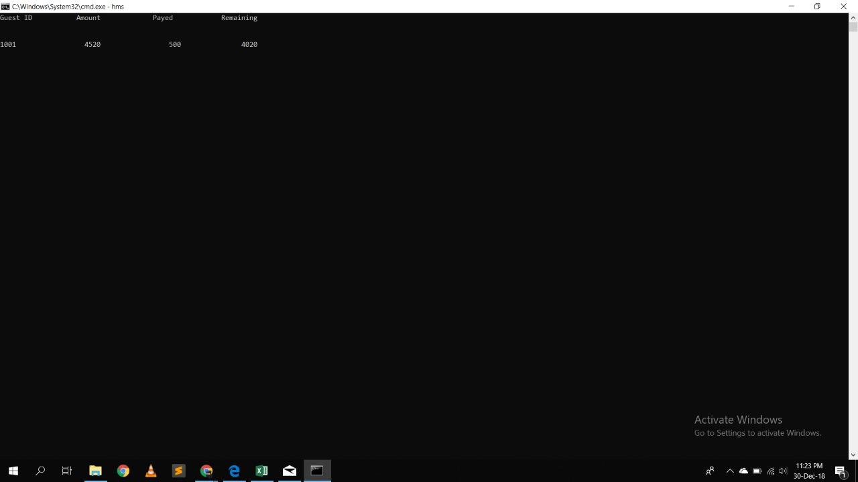
Module 3: BILLS

Slide 8
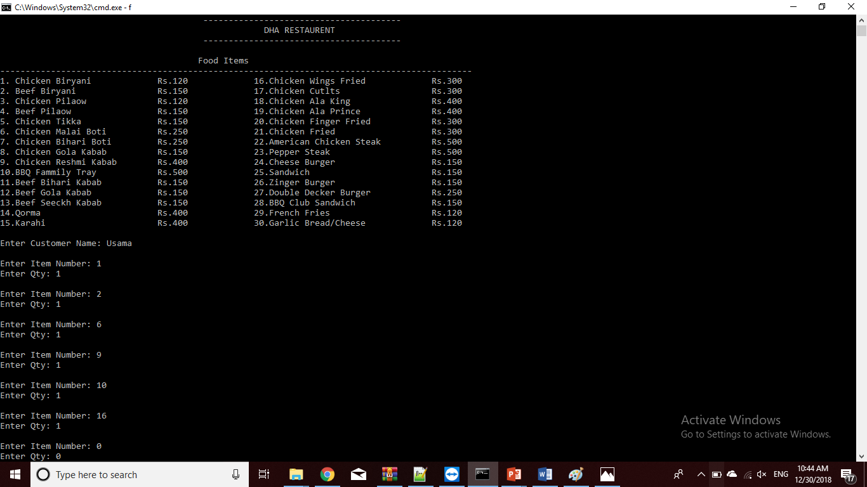
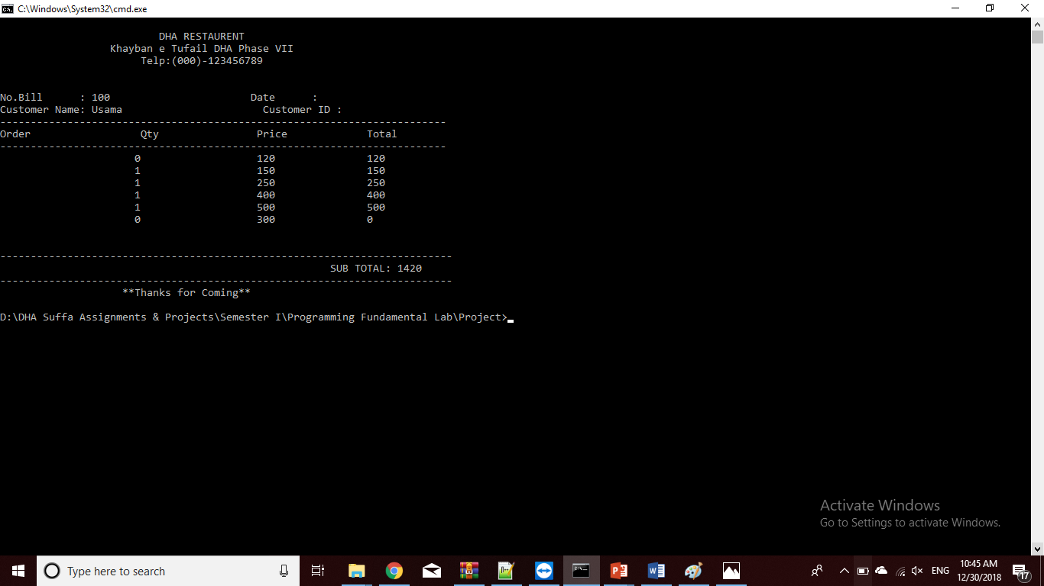
Module 4: Restaurant
Restaurant Menu
Restaurant Bill

Slide 9
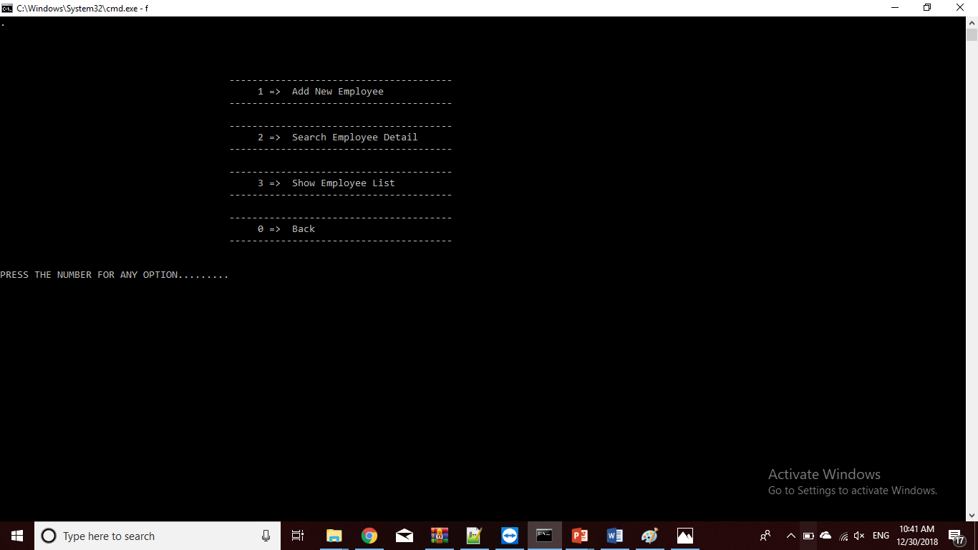
Module 5: Staff Members

Slide 10
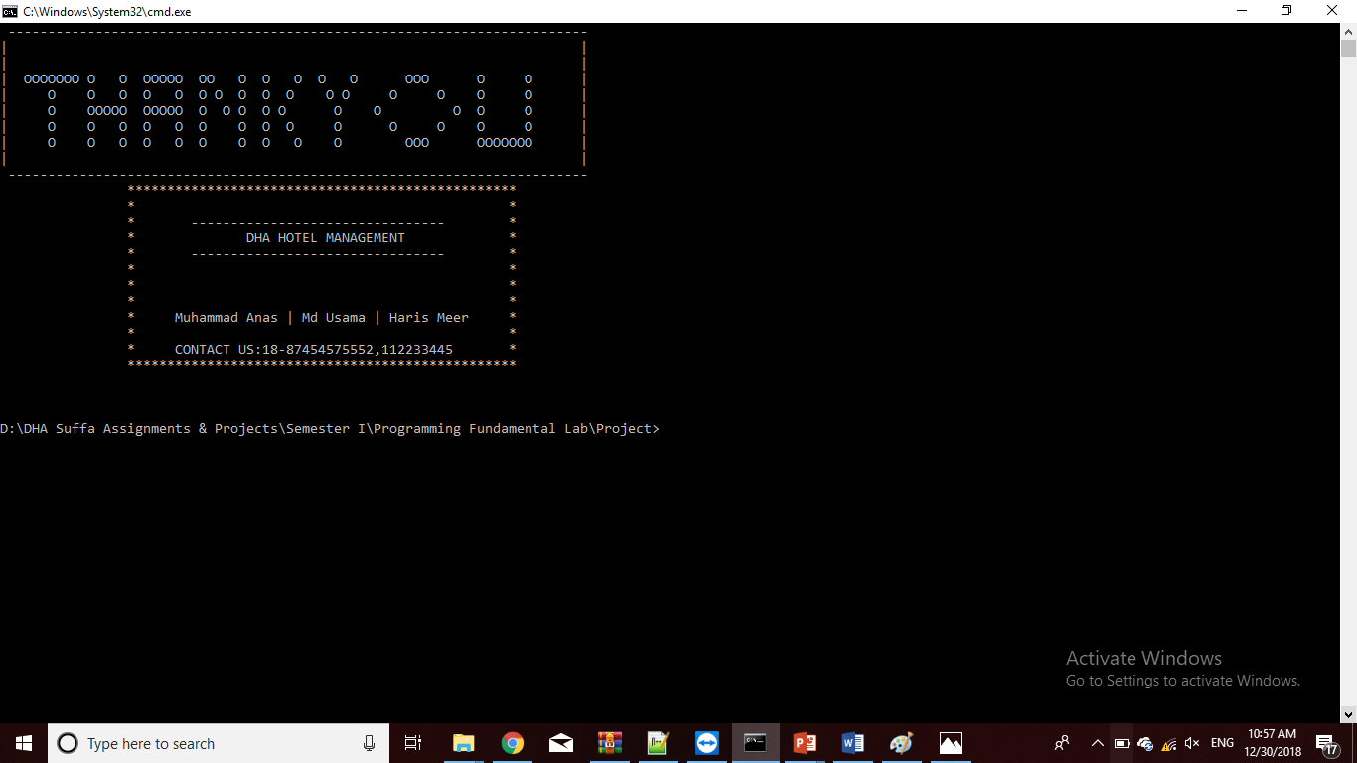
Exit Page

